Slide 1

Sahara by SegmentFault
Jibraan Mubeen, Ishmeet Tuteja, Darius Jones, Shamari Southwell

Slide 2
Group Member Roles
Ishmeet Tuteja – Developer
Darius Jones – Developer
Jibraan Mubeen – Client
Shamari Southwell - Client

Slide 3
Project Rationale
The shopping application project was chosen because creating a shopping application would give us a valuable experience that would build a set of significant skills. These skills would then easily translate into a real-world career in the field of computer science.

Slide 4



Tools Used
Netbeans
SQLite
Users Folder
Products
Github
Repository
GroupMe
Communication

Slide 5

Client Requirements
Request: Electronics Shopping Application
A user-friendly platform allowing their users to electronically browse and purchase products

Slide 6
Workflow Requirements
Login Page
Login with email and password if already a member
Sign up if not already member
Home Page
Search function
Accounts Page
Order History
Ability to edit account information
Checkout Page
Displays product and price of product being purchased
Entry of name, card info of user
Shipping Page
Entry of shipping address, billing address, and phone number
Review Order Page
Displays information from checkout and shipping pages
Confirm Order Page
Order Number and email confirmation to buyer

Slide 7
WSD
client side view
finding bugs
testing the program
Client
Developer
Shamari Southwell
Group Coordinator
GANTT Chart
WSD
Function Point Analysis
Dictionary
COCOMO
Darius Jones
server-side
Performance Improvement
Sahara
RTM
Use Cases
Testing
Dictionary
COCOMO
Developer
Client
risk mitigation
server-side
timeline, and cost control
Ishmeet Tuteja
Jibraan Mubeen

Slide 8
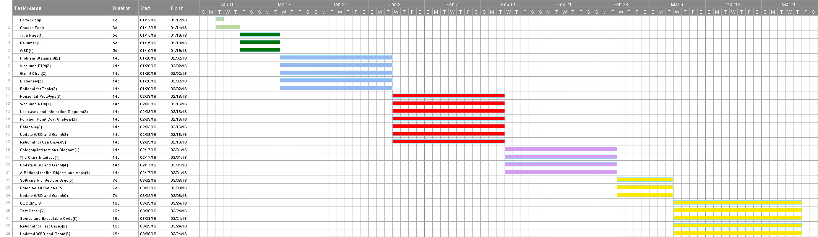
Gantt Chart

Slide 9
RTM
Entry # | Para #* | System Specification Text | Type | Use Case Name
1 | 1 | The login page shall have sign up functionality | SW | UC1: Signs Up
2 | 1.1 | The sign up functionality shall require entry of name, email, password(confirm password) | SW | UC1: Signs Up
3 | 2 | The login page shall have log in functionality | SW | UC2: Signs In
4 | 2.1 | The login shall include username/email and a password | SW | UC2: Signs In
5 | 2.2 | It shall have a home page | SW | UC2: Signs In
6 | 2.3 | The site shall include a logout option on every page | SW | UC2: Signs In
7 | 2.4 | A user database shall contain all user information (name, email, password) | SW | UC2: Signs In
8 | 3 | The site shall have an account page | SW | n/a
9 | 3.1 | The account page shall save the order history of the user | SW | UC3: Accesses and Manuevers Accounts Page
10 | 3.2 | The account page shall contain an order tracking feature | SW | UC3: Accesses and Manuevers Accounts Page
11 | 3.3 | The account page shall store a shipping address | SW | UC3: Accesses and Manuevers Accounts Page
12 | 3.4 | The account page shall also have a wish list feature | SW | UC3: Accesses and Manuevers Accounts Page
13 | 4 | The site shall have a shipping page | SW | n/a
14 | 4.1 | The shipping page shall ask for a shipping address | SW | UC4: Shipping Page

Slide 10
RTM
15 | 4.2 | The shipping page shall ask for a billing address | SW | UC4: Shipping Page
16 | 4.3 | The shipping page shall ask for a phone number to contact the buyer with | SW | UC4: Shipping Page
17 | 5 | There shall be a checkout page | SW | n/a
18 | 5.1 | The checkout page shall require the name of the buyer or user | SW | UC5: Confirm Order Page
19 | 5.2 | The checkout page shall require the card information of the buyer or user | SW | UC5: Confirm Order Page
20 | 5.3 | The checkout page shall show the product being purchased | SW | UC5: Confirm Order Page
21 | 5.4 | The checkout page shall show the price of the product being purchased + tax | SW | UC5: Confirm Order Page
22 | 6 | The site shall include a review order page | SW | n/a
23 | 6.1 | The review order page shall include all the information from checkout and shipping pages | SW | UC6: Checkout Page
24 | 6.2 | The review order page shall also include an expected date of arrival | SW | UC6: Checkout Page
25 | 6.3 | The site shall include a confirm order page | SW | UC6: Checkout Page
26 | 6.4 | The confirm order page shall include an order# | SW | UC6: Checkout Page
27 | 6.5 | The confirm order page shall contain an email | SW | UC6: Checkout Page
28 | 6.6 | The confirm order page shall contain an email confirmation feature | SW | UC6: Checkout Page

Slide 11
Use Case
Use Case 1: User Sign up
Overview: This use case enables a user to sign up for an account on the online shopping site (Sahara). This process requires user to enter his/her name, email, password and confirm password.
Preconditions:
User is a new to the site. This means the user has not signed up for the site before.
Database is accessible
Scenario:
Action | Software Reaction
User clicks sign up button on upper right corner of the home page | User taken to sign up page consisting of fields for first name, last name, email, and password.
Fill in “First Name” field | Field is filled
Fill in “Last Name” field | Field is filled
Fill in “Email” field | Field is filled
Fill in “Password” field | Field is filled
Fill in “Confirm Password” field | Field is filled
Press Submit button | All data from the fields are pushed to database. Notification is sent to user informing them of a successful signup.
Receive successful signup notification | N/A

Slide 12
Use Case
Scenario notes:
There is an error check to check whether or not a field is filled. If not, then progress cannot be made until that field is filled.
Post conditions:
First Name is updated in the DB
Last Name is updated in the DB
Email is updated in the DB
Password is updated in the DB
User is sent a success notification (after successful signup)
Exceptions: Use Case Utilized:
The DB cannot be accessed None
Required GUI: Time Constraints:
Homepage None

Slide 13
Test Case
Attributes | Description
Name | Logging in
Location | LogIn.java
Input | Email: ishsingh2016@gmail.com Password: Letmein
Oracle | Checks database to see that info is correct and then redirects to Home Page
Log | Redirects to Home Page, doesn’t check database.

Slide 14
Function Point Cost Analysis
Weighting Factor Estimation
Measurement Parameter | Count | Simple
Number of User Inputs | 16 | 3 | 48
Number of Users | 18 | 4 | 72
Number of User Inquiries | 16 | 3 | 48
Number of Files | 1 | 7 | 7
Number of External Interfaces | 1 | 5 | 5
Total |  |  | 180

Slide 15
Function Point Cost Analysis
Factor | Value
Backup and Recovery | 2
Data Communications | 5
Distributed Processing | 0
Performance Critical | 5
Existing Operating Environmental | 2
On-line Data Entry | 2
Input Transaction Over Multiple Screens | 0
Master Files Updated On-line | 0
Information Domain Values Complex | 3
Internal Processing Complex | 1
Code Designed for Reuse | 4
Conversion/Installation in Design | 1
Multiple Installations | 3
Application Designed for Change | 5
Complexity Adjustment Factor | 0.554
 | 33.554
FP = Total * (0.65+0.01*40.589) | FP = 180 * (0.65+0.01*33.554) | FP = 177.40

Slide 16
COCOMO
Multiplier | Rationale | Value
Reliability (RELY) | The effect of a software failure is a low level and easily-recoverable loss to users. | 0.88
Database (DATA) | D<10 | 0.94
Complexity (CPLX) | Control Operations, Computational Operations, Device-dependant Operations, Data Management Operations | 0.70
Timing (TIME) | Execution time constraint around 40% use of available execution time | 1.00
Storage (STOR) | Main storage constraint about 33% use of available storage | 1.00
Machine (VIRT) | The product line to be updated quite often, causing major change about every 2 months. | 0.87
Turnaround (TURN) | Turn around time to be interactive. | 0.87
Analyst Capability(ACAP) | Analyst capability to be a normal amount probably around the 50th percentile of analysts. | 1.00
Applications Experience (AEXP) | Application experience about 1 year | 1.13
Programmer Capability (PCAP) | Programming capability is average or within the 55th percentile. | 1.00
Virtual Machine Experience (VEXP) | Our virtual Machine Experience is a little less of 4 months. | 1.10
Programming Language Experience (LEXP) | At least 3+ years of programming language experience combined. | 0.82
Use of Modern Programming Practices (MODP) | Use of modern programming practices such as design and code walkthroughs or inspections. | 1.00
Use of SW Tools (TOOL) | Tools used include databases and IDE | 1.24
Schedule Constraint (SCED) | Due to dropout of group member, chances of delay is high (about 30% above nominal) | 1.00

Slide 17
COCOMO
EAF = 0.88*0.94*0.70*1.00*1.00*0.87*0.87*1.00*1.13*1.00*1.10*0.82*1.00*1.24*1.00
E = 3.2*6^{1.05}*0.554
D = 2.5*11.63^{0.38}
Dollars = 11.63*6000
EAF = 0.554
E = 11.63 PM (Programmer Months)
D = 6.35 Months
Dollars = $69,780

Slide 18
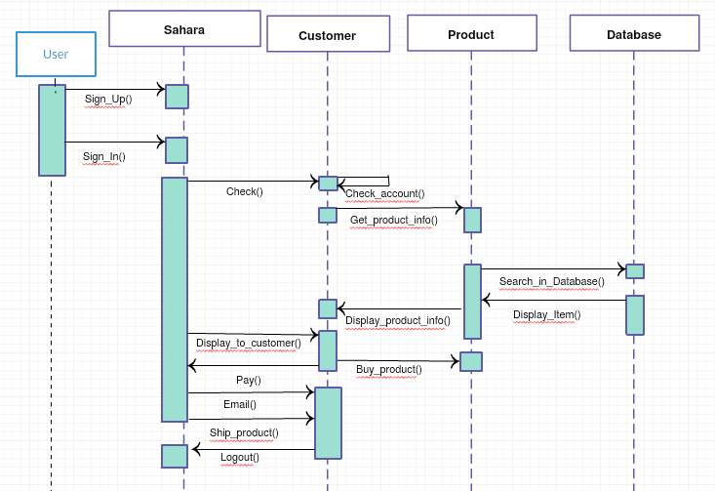
Sequence Diagram

Slide 19
Legacy
Positives
Application has User profiles which are connected to their email
First time experience with Java FX and SQLite
Negatives
Doesn’t have some of the features we wanted such as email confirmation.
We also went through something most people don’t which is the drop of a team member. Though in real life you are still required to complete the project.
Need better planning and work communication.
Add more functionality and design to the project.

Slide 20
Conclusion
Positives
Team chemistry, we worked well together
Negatives
Lost a team member during a crucial part of the project
Compensate by reallocating tasks and adjust to increase on individual workload
Demo
Misunderstanding of the scope of the application
Values in the Function Point Cost Analysis and COCOMO

